Slide 1
Hadoop DistributedSum Example
CSC 4760 / 6760 Big Data Programming
Spring 2018
Chapter 1 Design Patterns and MapReduce. Book: MapReduce Design Patterns, Donald Miner & Adam Shook, 2012.

Slide 2
Distributed Sum
1
4
5
10
9
6
2
3
7
Input data file
each line contains a integer
we want to sum all the integers together

Slide 3
Distributed Sum
1
<null, 1>
<null, 4>
<null, 5>
1
4
5
10
9
6
2
3
7
sum
<null, 10>
4
5
10
<null, 10>
<null, 9>
<null, 6>
<null, 10>
<null, 25>
<null, 12>
sum
sum
9
<null, 25>
<null, 47>
6
2
<null, 2>
<null, 3>
<null, 7>
single reducer
sum
3
<null, 12>
7
Splits
Mapper
Combiner
Shuffle
Reducer

Slide 4
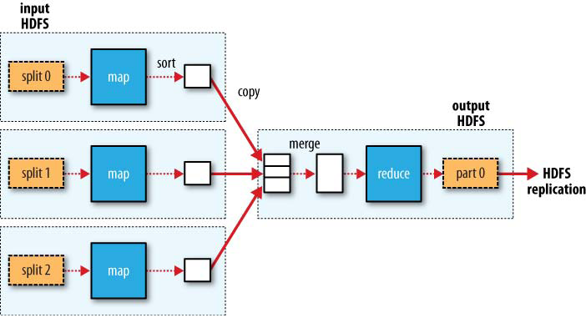
Single Reducer

Slide 5
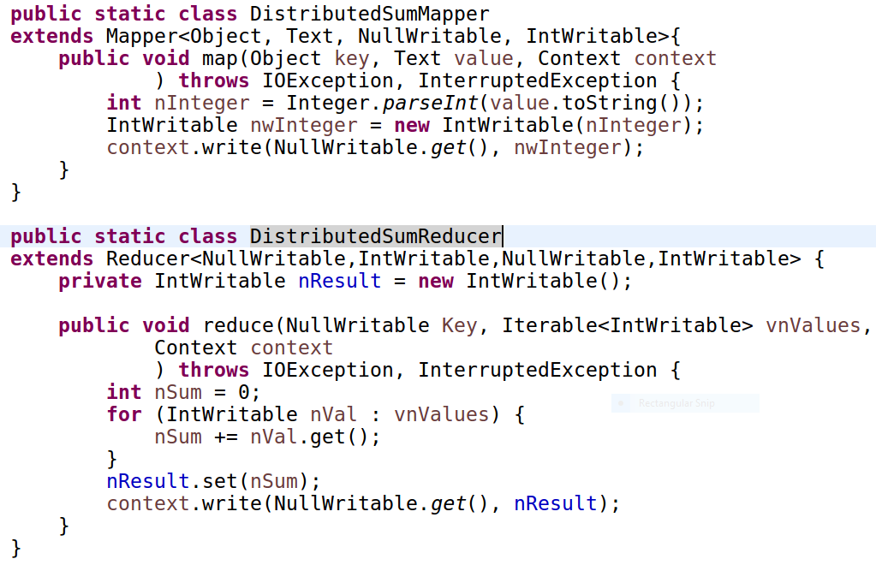
Mapper
Output the input
Reducer / Combiner
Sum all integers

Slide 6
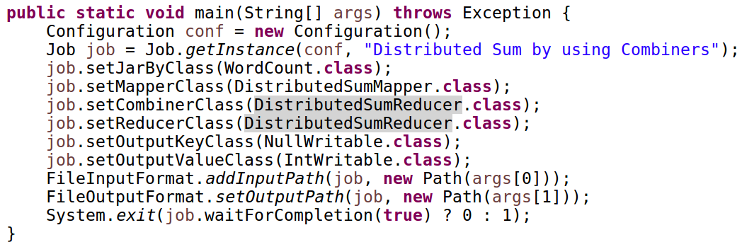
main() function

Slide 7
Distributed Sum
1
4
5
1
4
5
10
9
6
2
3
7
sum
10
10
9
6
10
25
12
sum
sum
25
47
2
3
7
single reducer
sum
12
Splits
Mapper
Shuffle
Reducer

Slide 8
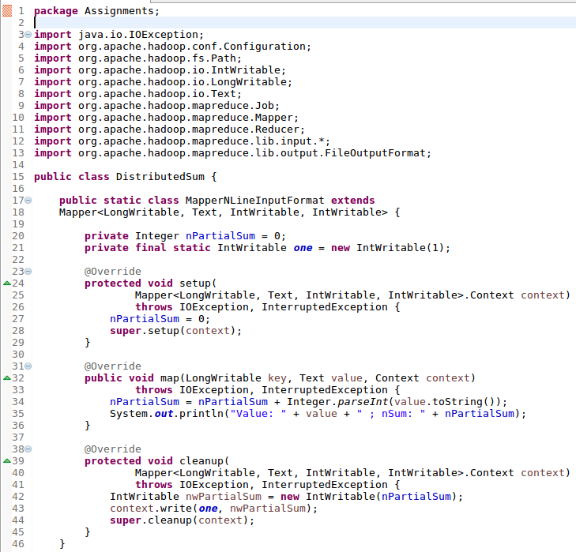
Mapper
<InKey, InValue, OutKey, OutValue>
initialization
sum all values
One mapper. But it will processes one line in each map()
emit the final value

Slide 9
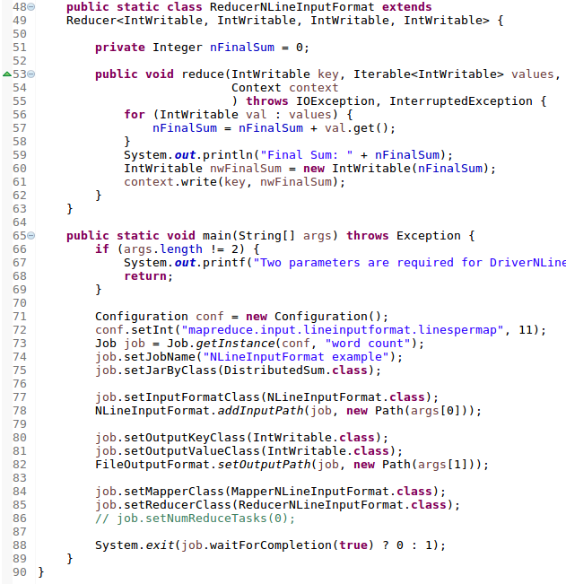
Reducer and Main
<InKey, InValue, OutKey, OutValue>
sum all values
conf and job instances are created
We change the InputFormatClass to “NLineInputFormat”
Set up the output <key, value>
set up mapper and reducer

Slide 10
Commands to run the program
$ hadoop jar DistributedSum.jar file:///home/rob/Assignment1/numbers.txt file:///home/rob/Assignment1/numbers_output01
You can also comment the line “job.setReducerClass(…)” in the main()
and uncomment the line “job.setNumReduceTasks(0)” in the main()
Run the above command again, you will see the outputs from the mapper

Slide 11
InputFormatClass
By default, the “InputFormatClass” is “TextInputFormat”.
That is why the Mapper’s input is one line of the text document.
Now we change it to “NLineInputFormat”, which lets the Mapper to read multiple lines.

Slide 12
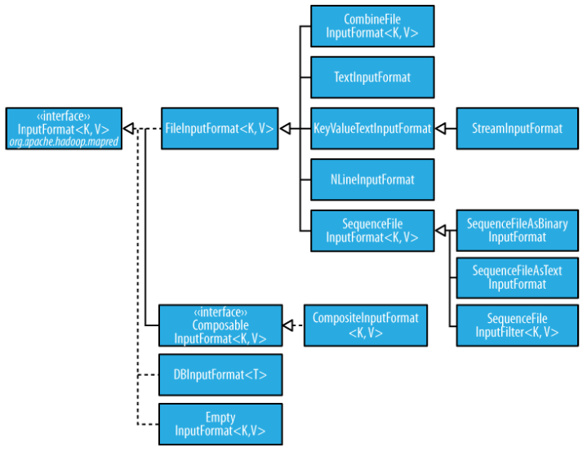
InputFormat class hierarchy
default
Your own class

Slide 13
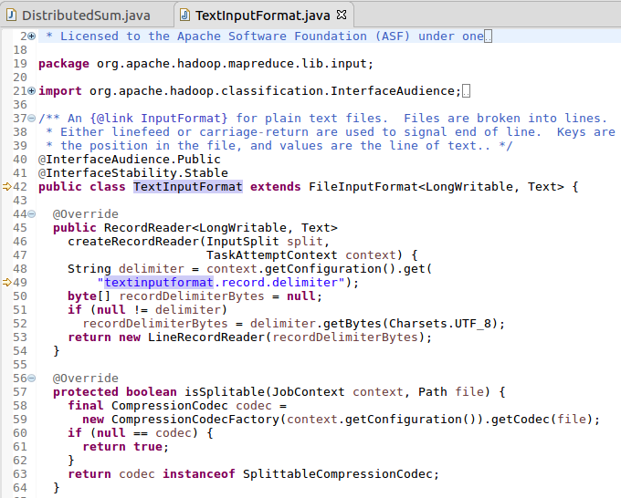
TextInputFormat
An InputFormat for plain text files. Files are broken into lines. Either linefeed or carriage-return are used to signal end of line. Keys are the position in the file, and values are the line of text.
API Document:
http://hadoop.apache.org/docs/r3.0.0/api/org/apache/hadoop/mapred/TextInputFormat.html

Slide 14
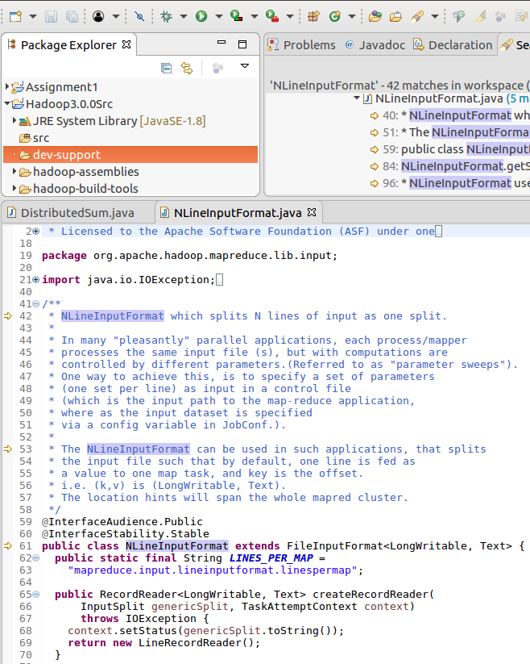
NLineInputFormat
API Document:
https://hadoop.apache.org/docs/r3.0.0/api/org/apache/hadoop/mapred/lib/NLineInputFormat.html
NLineInputFormat which splits N lines of input as one split.

